Slide 1
Identifying genomic markers of drug response (an analysis in R)
ICR Bioinformatics introduction
3rd June 2015

Slide 2
What we will cover:
What Garnett et al. did and what they found
Load the Garnett et al. data set, prepare and overview
Analyse and summarise

Slide 3
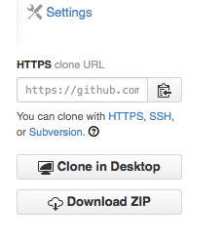
Download from share or Github
Genomics of Drug Sensitivity in
Cancer (cancerrxgene.org)
Copy the folder genexdrugdemo from the //icrshare drive
Or git clone from github
git clone \
https://github.com/DrJCampbell/genexdrugdemo.git
Or download a zip file from github
https://github.com/DrJCampbell/genexdrugdemo/archive/master.zip

Slide 4
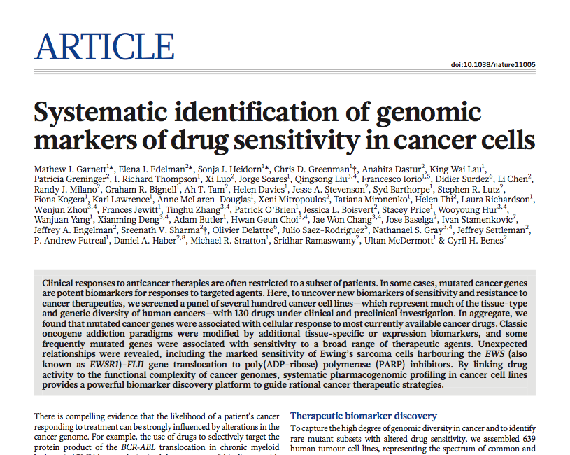
The data set
PMID: 22460902
What Garnett et al. did
Mutation, CNA and expression
IC50 estimates for compounds
MANOVA, elastic net
Gene-drug associations

Slide 5
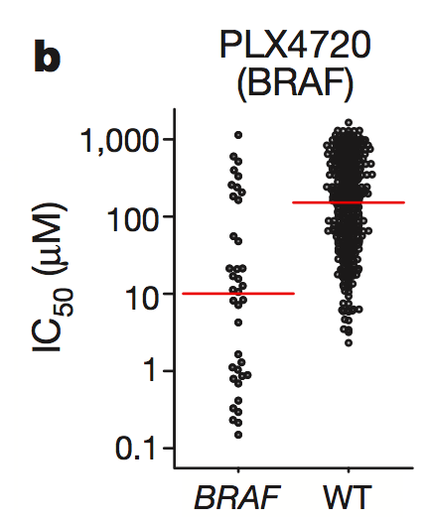
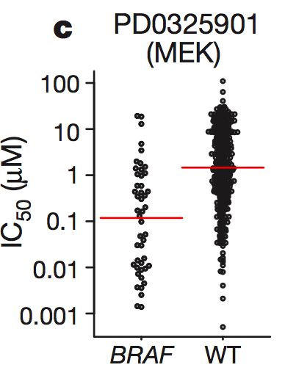
Garnett et al., 2012
Results examples

Slide 6
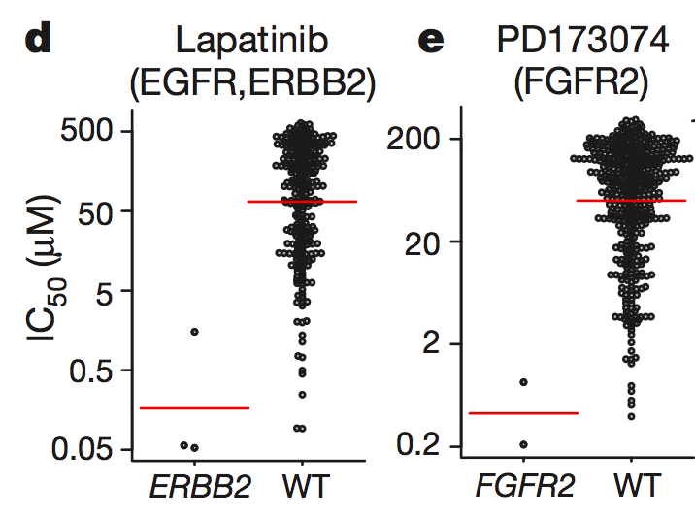
Garnett et al., 2012
Results examples

Slide 7
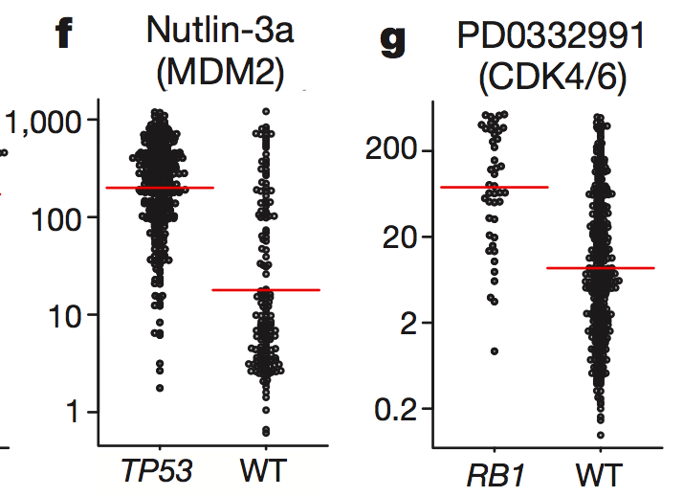
Garnett et al., 2012
Results examples

Slide 8
Explanation for examples
Massively simplified
RTK
Lapatinib (EGFR)
PD173074 (FGFR)
MDM2
Nutlin
RAS
TP53
RAF
PLX4720
CycD+CDK4/6
PD0332991
MEK
PD0325901
RB1
ERK
E2F

Slide 9
Overview of Our Analyses
Steps in R
Set up (load functions, set dir)
Load data sets and check them
Test a single association
Test all associations
Visualise the results

Slide 10
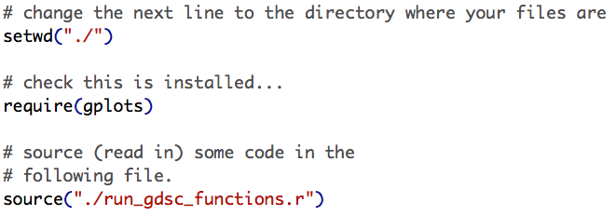
Analysis Stage 1a
Set up, load data and take a look
Set the working directory, load modules and predefined functions

Slide 11
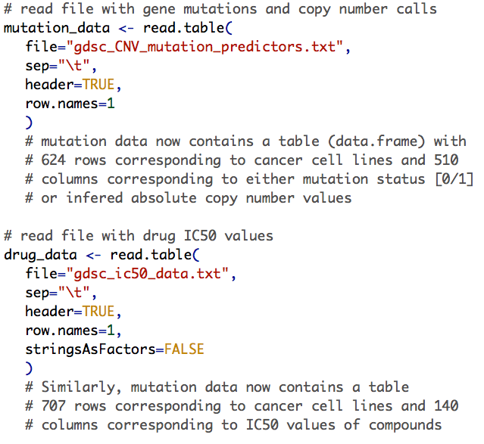
Analysis Stage 1b
Set up, load data and take a look
Read the mutation data table
Get a 624 x 510 element table
Read the drug IC50 data table
Get a 707 x 140 element table

Slide 12
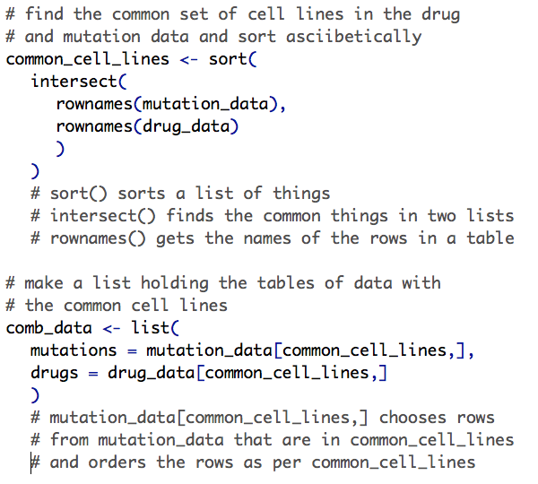
Analysis Stage 1c
Set up, load data and take a look
Get a list of cell lines in both tables (common row names)
Organise the data tables with common rows…

Slide 13
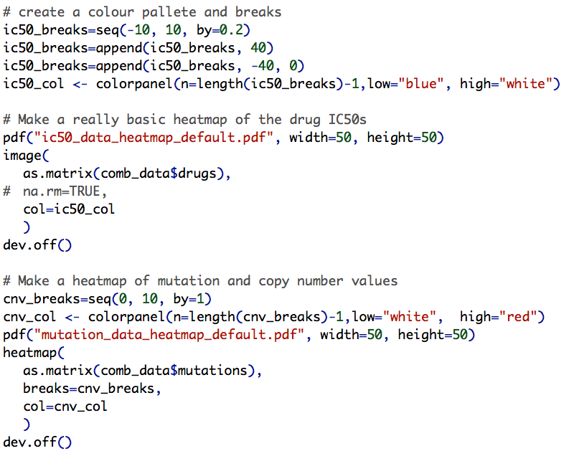
Analysis Stage 1d
Set up, load data and take a look
Define a colour palette and break points
Make a simple heatmap of IC50 values with image()
A fancier heatmap for the mutation data set

Slide 14
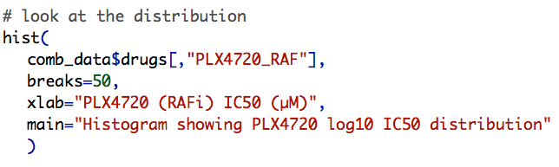
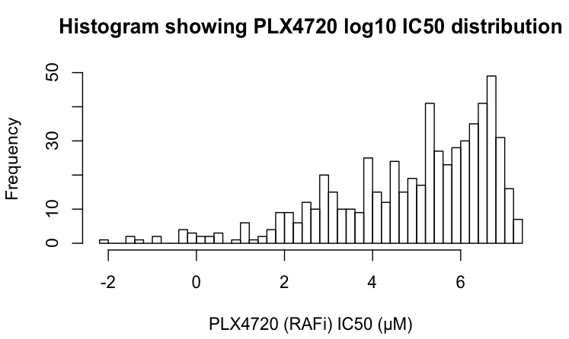
Test BRAF/RAFi Association
Spearman Rank Correlation

Slide 15
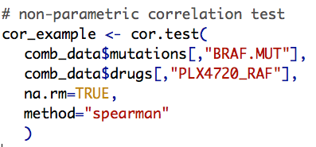
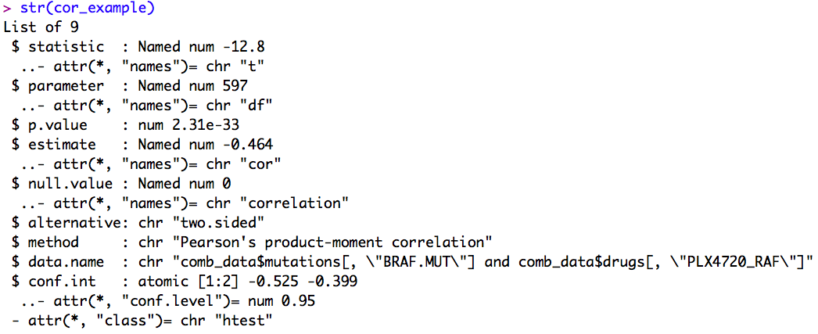
Test BRAF/RAFi Association
Spearman Rank Correlation

Slide 16
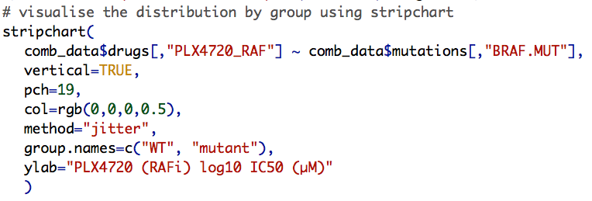
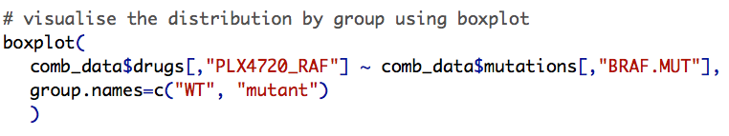
Test BRAF/RAFi Association
Spearman Rank Correlation

Slide 17
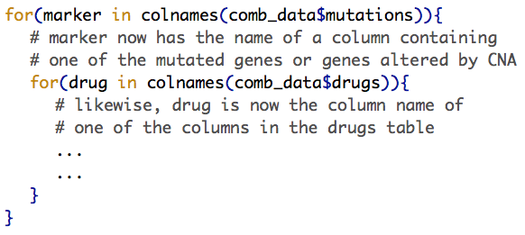
Test all gene/drug associations
Looping and cor.test()
Do something here that operates on the columns from the drug and mutation data tables.

Slide 18
Visualise a subset of statistically significant gene-drug associations
Boxplot by mutation status
BRAF mutation correlates with sensitivity to multiple RAF and MEK inhibitors

Slide 19
Visualise a subset of statistically significant gene-drug associations
Boxplot by copy number
TP53 deletion correlates with resistance to nutlin (r=0.43, p=6.5e-29)

Slide 20
Sum up
What is you wanted to do this for real?
Spearman Rank Correlation is not the only or the best option (Mann-Whitney, ANOVA, EN regression?)
Contribution of other factors such as histotype are probably relevant
Layer other biological information sources on top of the association tests to lend support (or not)

Slide 21
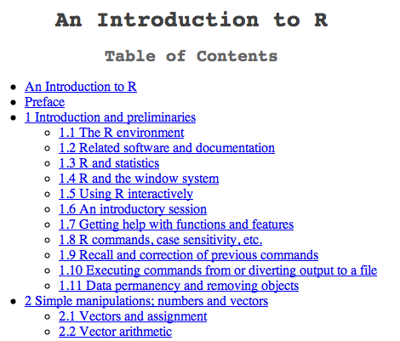
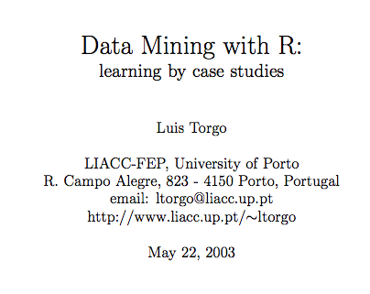

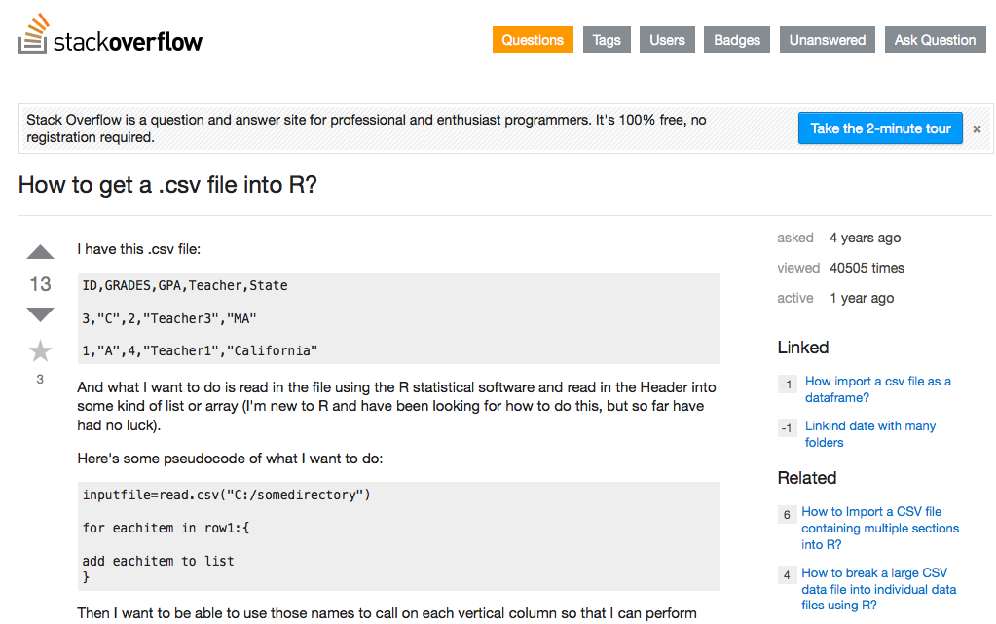
Sum up
Useful sources of information

Slide 22
There’s more if you want it
jhg
Identifying Genetic Dependencies in Cancer by Analyzing siRNA Screens in Tumour Cell Line Panels (methods book chapter)
Download code from github and check readme
https://github.com/DrJCampbell/identifying-genetic-dependencies/archive/master.zip
Covers analysis of siRNA screens with cellHTS, identification of genetic dependencies and integration with functional interaction data sets

